Slide 2
Previously..
Graph theory and algebraic graph theory review

Slide 3
Sistem Pengaturan Formasi dan Kolaborasi
EE185523
Matrix Theory (Review)
Yurid Eka Nugraha
TSP DTE FTEIC ITS

Slide 4




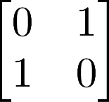
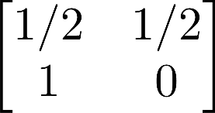
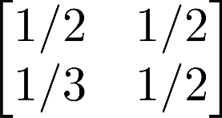
Eigenvalues and eigenvector
Definition:
is an eigenvalue of with eigenvector
if satisfies
Example:
left?
right?
EE185523 2022E – 2

Slide 5



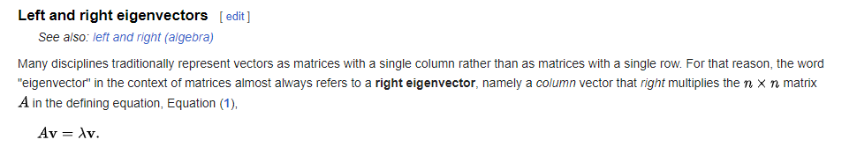
Eigenvalues and eigenvector
Definition:
is an eigenvalue of with eigenvector
if satisfies
Example:
EE185523 2022E – 2

Slide 6




Stochastic matrices
Definition:
is:
Non-negative if
Row stochastic if non-negative and
Column stochastic if non-negative and
Doubly stochastic if row stochastic and column stochastic
Example:
EE185523 2022E – 2

Slide 7
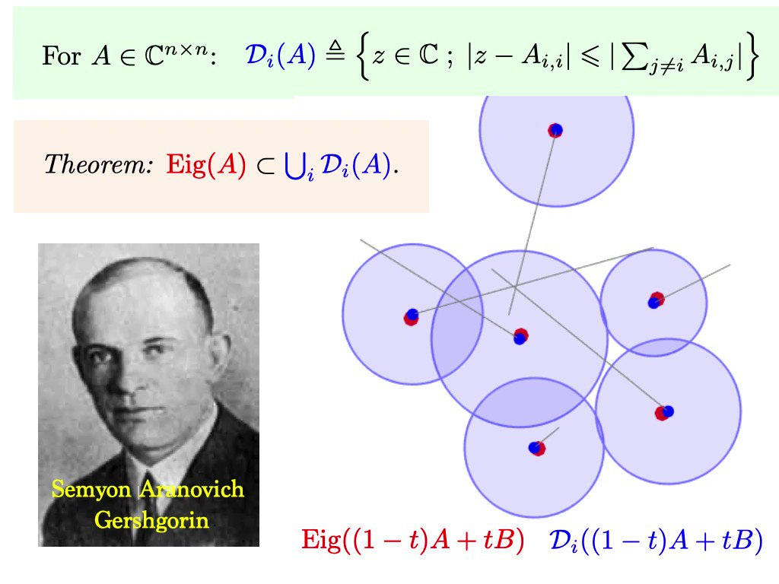
Spectral properties
Gersgorin disk theorem:
https://www.geogebra.org/m/wDEj3Xg9
Lemma:
For a row-stochastic matrix , the largest eigenvalue norm is 1
EE185523 2022E – 2

Slide 8



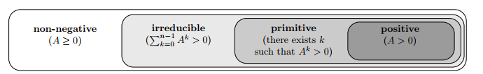
Irreducibility and primitive matrices
Definition:
is:
Irreducible if non-negative and is positive
Primitive if there exists non-negative such that positive
A primitive matrix is always irreducible
EE185523 2022E – 2

Slide 9





Perron-Frobenius theory
Perron-Frobenius Theorem:
If is non-negative, then
there exists a real eigenvalue for all other eigenvalues
the eigenvectors of can be selected non-negative
If additionally is irreducible, then
the eigenvalue is strictly positive and simple
the eigenvectors of are unique and positive
If additionally is primitive, then
the eigenvalue satisfies
EE185523 2022E – 2

Slide 10
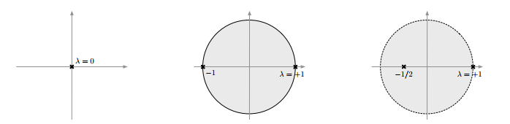
Perron-Frobenius theory
reducible matrix
irreducible but not primitive
primitive
EE185523 2022E – 2

Slide 11



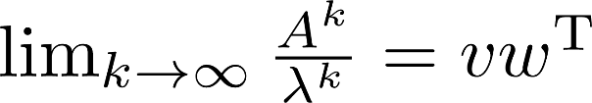

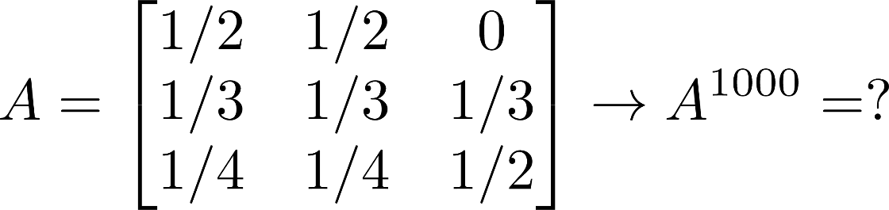
Application: matrix powers
Theorem:
For a primitive matrix with dominant eigenvectors and :
with .
Example:
EE185523 2022E – 2

Slide 12

Discrete linear systems
or..
EE185523 2022E – 2

Slide 13




Semi-convergent and convergent matrices
Definition:
is:
Semi-convergent if exists
Convergent (also called Schur stable) if it is semi-convergent and
If is semi convergent with , then
EE185523 2022E – 2

Slide 14
Assignment 1: Graph theory and Matrix theory
Homework problems will be uploaded to myITS classroom (as well as the slides)
Deadline: one week after the problem uploaded

